Slide 1

Human Resource Management System
Submitted by: Supervisor:
WESAM DAABESD DR.MOHAMMAD TAYE
FAHED KHALIL
MALIK QAWASMEH

Slide 2
Chapter 1: Proposal (System Conception)
1. Introduction:
The proposed project "HR Management System" has been developed to overcome the problems faced in the practicing of manual system. This software is built to eliminate and in some cases reduce the hardships faced by the existing system. Moreover this system is designed for particular need of the company to carry out its operations in a smooth and effective manner.
It is a special system for employees in any company in which basic jobs are available for any employee, such as (vacations - leaves – edit info - monthly salary ).

Slide 3
2. Objective:
1) Useability and efficiency of employees services.
2) Generate reports of employee leaves or vacation and complaints.
3) To Add the employee salary.

Slide 4
3. Problem Statement:
Overcoming the problems facing the manual system and creating transactions electronically to make it easier for employees and management to communicate between them .

Slide 5
Chapter 2: Requirements Engineering Part
1. Stakeholders:
Actor | Interests
Managing Director | Salary, Job security, Managing vacation request and reports.
Employees | Salary, Job security, Vacation request or reports.
Company Owners | Business operations to run smoothly, Profit.
IT Developer | Create the website, Level of security, Privacy, Data Storage.

Slide 6
2. Strengths and Weakness of the System:
The Strength Of Paper System Is : Documentation
The Weaknesses Of Paper System Is :
Prone to damage: Manual documents can be easily damaged, lost, or stolen.
Higher costs: Because we will need more paper, printers, copiers, stationery and other office supplies.
Lack of security: Paper is one of the biggest information security risks for companies because printed documents can easily be lost, mishandled, or destroyed while digital data can be encrypted and kept securely in hard disks or electronic devices.

Slide 7
3. Requirement Elicitation:
Questionnaire.
we can't meet the employee in this time cause of corona virus
For easy access to a larger number of employees and for accurate reports and Asking the employee easily than making and save time also.

Slide 8
Chapter 3: Software Requirements Specification (SRS)
1. Functional Requirements: (Admin)
Functional | Description
Login | Log in using the administrator number and password
Edit info and Change password | The Admin can change password and information in employee or your
Add new employee | The Admin can add a new employee
Accept or reject holiday or leave | The Admin can approve or deny a holidays or leave To the employee with the reason written
Add the salary | The Admin can Add the salary To the employee

Slide 9
1. Functional Requirements: (Employee)
Functional | Description
Login | Log in using the employee number and password
Edit info and Change password | The password and information change or restore
Request holiday or leave | Employees are allowed to request holiday or leave
view the salary | Employees are allowed to view the salary amount

Slide 10
2. Non-Functional Requirements
Usability:
the system is easy to use by the users, we tried to provide easy control interfaces in the design.

Slide 11
Chapter 4: Software Architecture
It’s a three tier Architecture.
• Three-tier architecture is a well-established software application architecture that organizes applications into three logical and physical computing tiers: the presentation tier, or user interface; the application tier, where data is processed; and the data tier, where the data associated with the application is stored and managed.
• The chief benefit of three-tier architecture is that because each tier runs on its own.
Three-tier application architecture is a modular client-server architecture that consists of a presentation tier, an application tier and a data tier. The data tier stores information, the application tier handles logic and the presentation tier is a graphical user interface (gui) that communicates with the other two tiers. The three tiers are logical, not physical, and may or may not run on the same physical server.

Slide 12
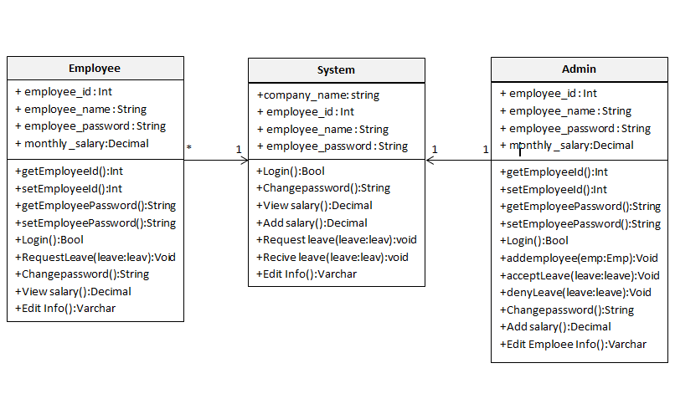
Chapter 5: Detailed Design
1. class diagram…

Slide 13
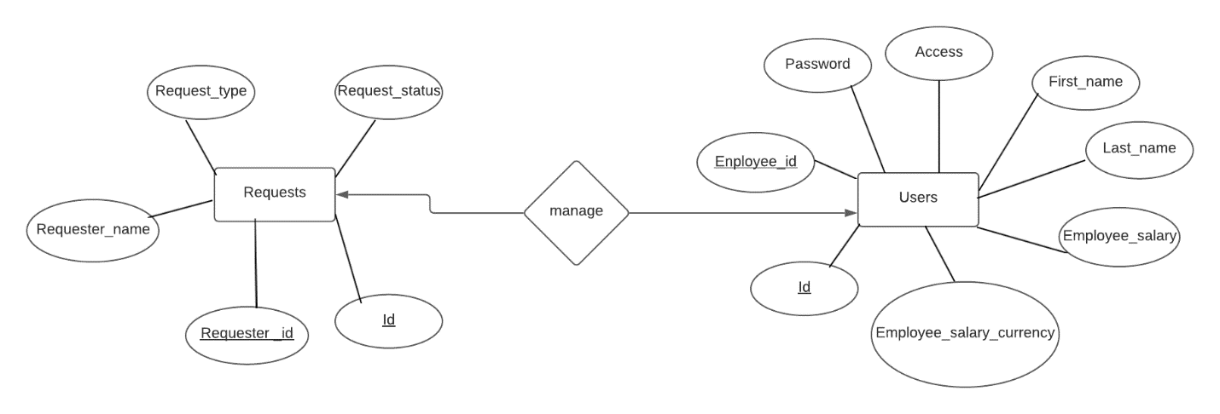
2. Database table…

Slide 14
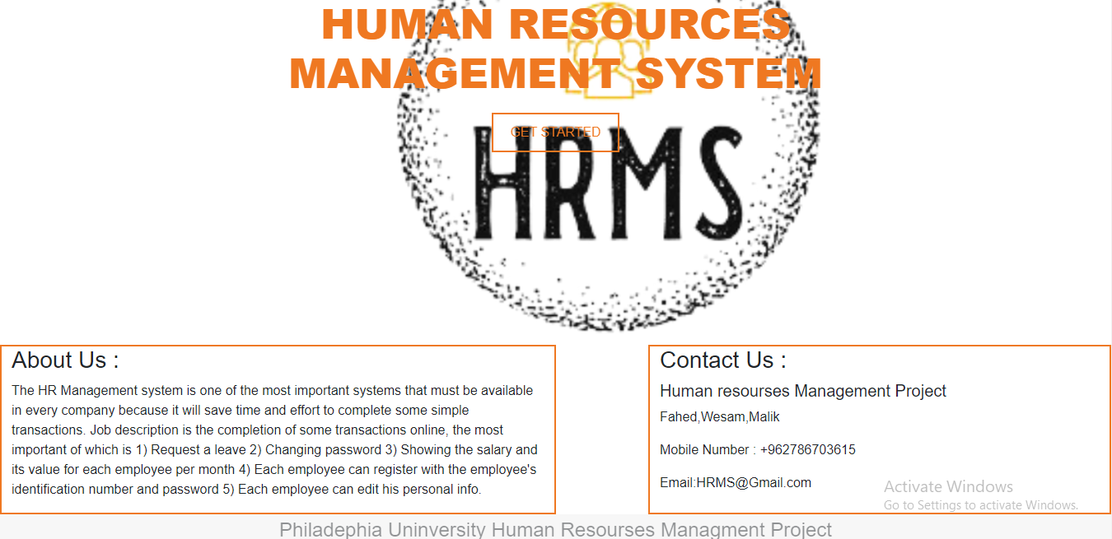
3. User Interface Design…
the welcome page of the project its contains about us and contact us and the button of login.

Slide 15
Chapter 7: Testing
1. Functional Test Cases:
Result | Expected Output | Actual Input | Test case | Test case number
pass | Login succeeds and home page presented | Employee id : 201710036 password : 12345 | Testing Login | 1
pass | Wrong username or password! | Employee id : 201720043 password : 12335 | Testing Login | 2
pass | Login succeeds and home page presented | Employee id : 0 password : 12345 | Testing login by admin | 3
pass | Wrong username or password! | Employee id : 0213 password : 12345 | Testing login by admin | 4
pass | Employee is added | Valid employee data | Add new employee by admin | 5

Slide 16
pass | Request is added | Valid request data | Add requests for employee by admin | 6
Pass | Employee is editing | Pressing submit button | Editing employee information by admin | 7
pass | Employee is editing | Pressing submit button | Edit personal employee information | 8
Pass | Status leave accepted | Enter valid Id and name and date | Approve a leave or vacation employee by admin | 9
Pass | status leave rejected | Enter valid Id and name and date | Deny a leave or vacation of employee by admin | 10
Pass | Password is changed | Enter valid new password | Change password by admin | 11
pass | Request is applied | Enter request type and date | Apply request by admin | 12

Slide 17
2. Sample of Effective Results:
1- log in using invalid employee number and password
2-The form must be filled out

Slide 18
Chapter 8: Conclusion and Future works
Conclusion:
After reviewing the current study and studying it thoroughly ,The Human Resource Management System is an effective system that could be applied and used in many companies . Accordioning to that the system was analyzed and work on establishing a system that manages human resources according to the foundation of any company.
By the website.1) Manager is able to rely on him to manage and control employee data, as well as to manage attendance and absence records.2) Manager also can manage the records of vacations and financial matters for all employees easily.3) By using the website, the administrator can extract reports by employees and all related information.4) Employee can manage his data easily.

Slide 19
Future work:
Develop more sections needed by human resources such as performance assessment and vocational training.
Analysis of the consequences of the system.
Develop the website and improve its performance by studying the conversion to Android and ios application, while the website remains.

Slide 20
References:
A. projects . “ Web student portal for the it and management": www.freeprojectz.com, Nov.7,2014* [March.10,3,2021].
Lecture
M. Taye. final project, Topic: “discussing.” IT 7405, Faculty of IT, University of Philadelphia, Jordan, Amman, April. 31, 2021.
E-mail
W.daabes “new message ,done?wesamdaabes98@gmail.com ”. (April.3,2021).
heart 1
Latest Projects on Java, JSP, Python, PHP, .Net, Android | FreeProjectz
Download free c++ projects, php projects, java projects, .net projects, visual basic projects, c projects for bca, mca, pgdca, cbse, b.tech,b.sc it, m.sc it

